Slide 1

Airline Safety
Current airline safety and airline travel analytics
DSC640 – Data Presentation & Visualization Executive Summary Sanjay Jaras

Slide 2
Overview
Due to recent unfortunate airline crashes, the media has been promoting statistics stating air is no longer a safe way to travel.
The news and media outlets have been bombarding the public with reports and figures about the trends of airline safety and that things are not looking good.
Air travel was previously thought as the safest way to travel, especially when compared to automobiles, is now being presented as one of the most dangerous to the public.
Based on data we tried to answer safety questions, and analytics about covid impact on profit/loss.

Slide 3
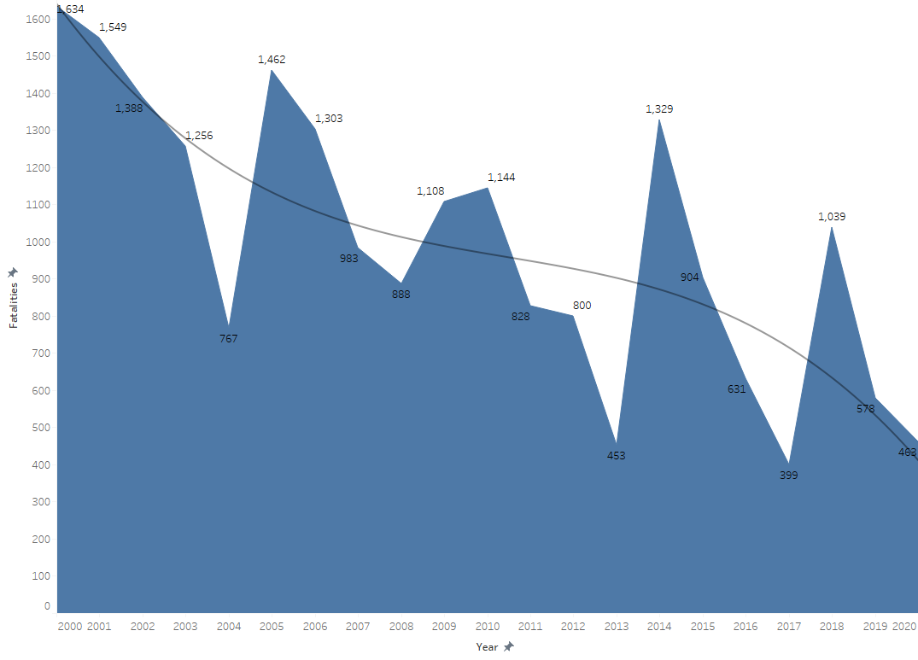
Air Travel Fatalities – U.S. & International Operators(2000-2020)
In the period 2000-2020, there are up-downs in fatalities with air travel.
However, overall it is showing a downward trend.
Source: Bureau of Aircraft Accident Archives

Slide 4
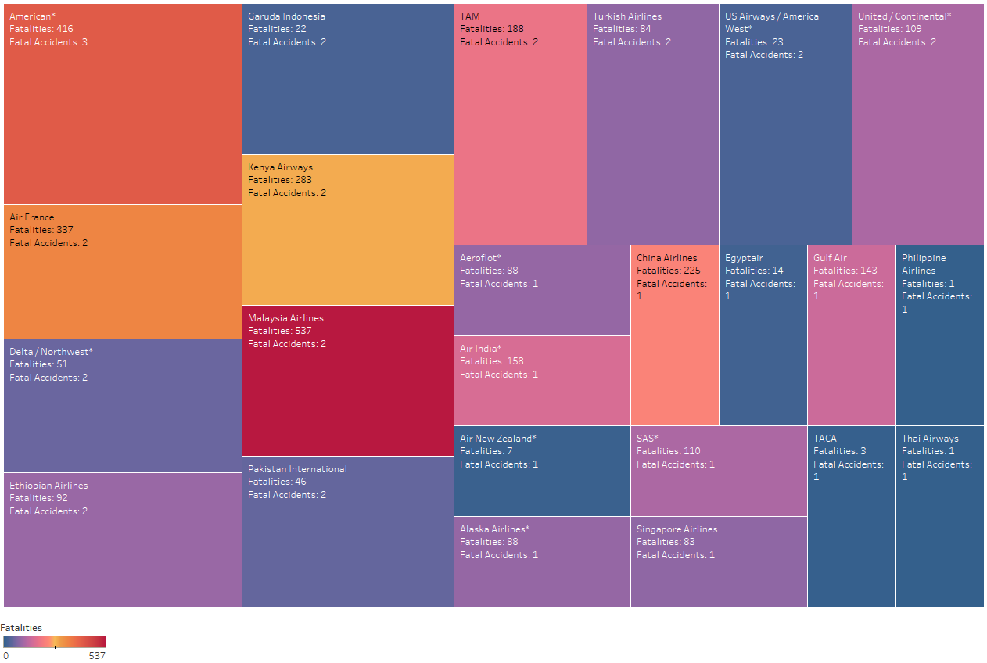
Fatalities and Fatal Accidents U.S. & International Operators (2000-2014)
Source: Aviation Safety Network

Slide 5
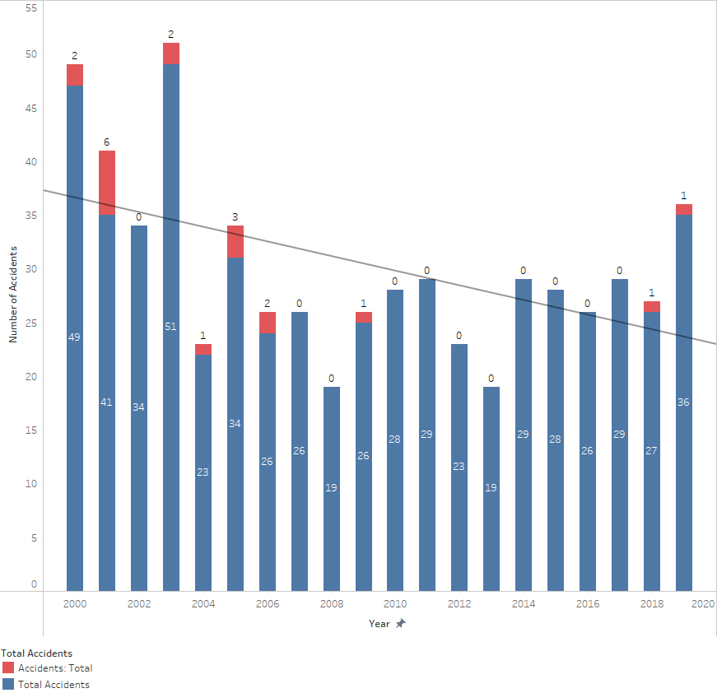
Accidents & Fatal Accidents by U.S. Operators(2000-2019)
The year 2003 has the most number of accidents 51.
The year 2001 has more fatal accidents(6).
The year 2019 shows a slight increase in the number of accidents but the overall trend is downward
Source: Airlines for America

Slide 6
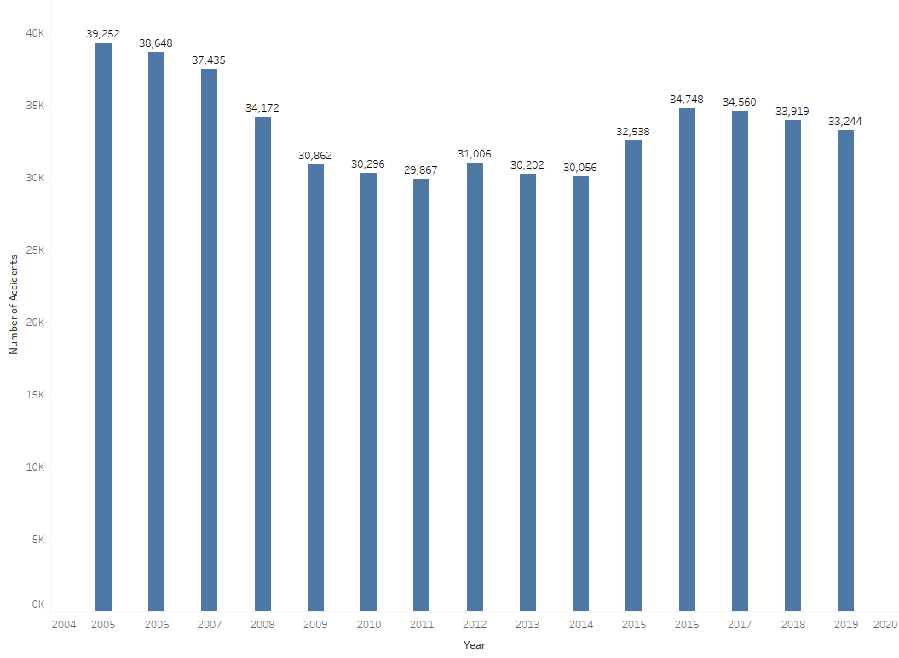
Fatal Road Accidents in U.S.(2005-2019)
On an average 33,387 fatal road accidents happened in U.S. in the period 2005-2019 per year.
While Air-travel has only 0.95 fatal accidents per year with U.S. operators.
Source: Airlines for America

Slide 7
Passengers and Profit/Loss Analysis
Air travel is still a reliable travel medium involved in very few fatalities compared to road travel and. The trust is also shown with the increasing number of passengers.
4.543 billion passengers used air travel in the year 2019.
The number of passengers increased from 1.77 billion to 4.72 billion with a growth of 166% since the year 2000.
U.S. operators’ revenue increased to $247.6 billion in the year 2019 compared to $155.1 billion in 2009.
Before covid disaster the net profit for global operators was $26.3 billion in the year 2019.
There is a loss of $89 billion due to covid crises in year the 2020.

Slide 8
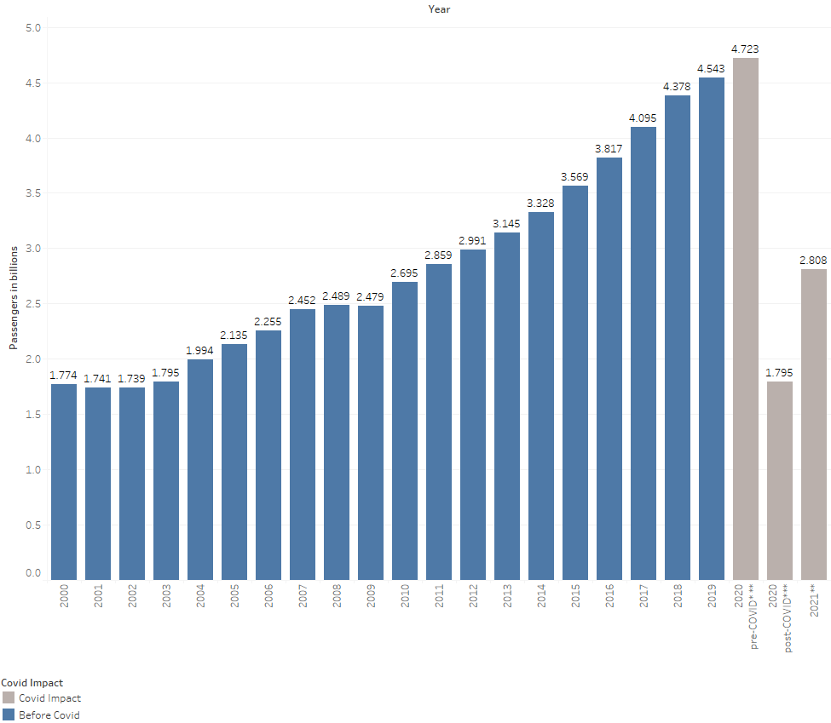
Worldwide Air passengers(2000-2020)
The number of passengers increased from 1.77 billion to 4.723 billion with a growth of 166% since the year 2000.
Covid reduced number of passengers to 1.8 billion as opposed to scheduled 4.7 billion in the year 2020
Source: Industry Statistics

Slide 9
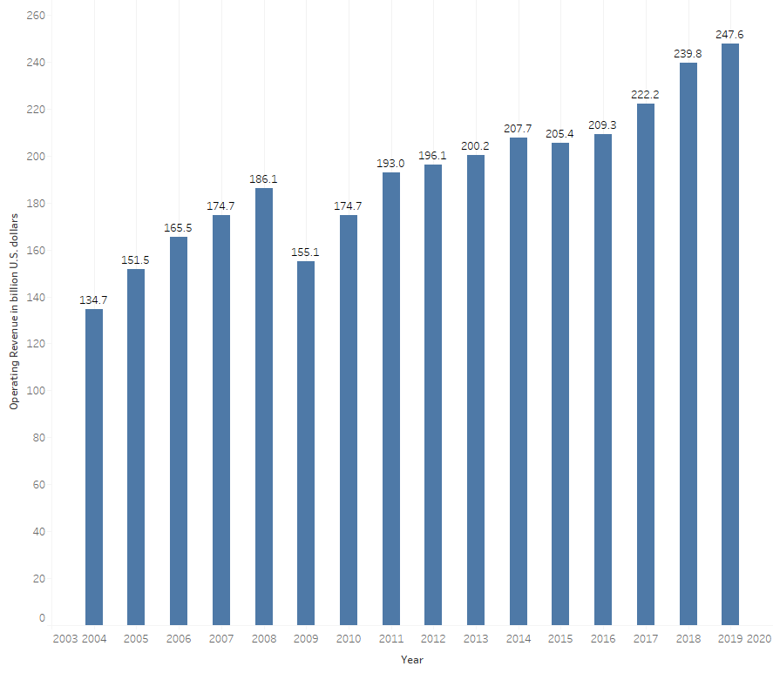
U.S. Airline operators Revenue(2004-2019)
The operating revenue of U.S. operators increasing with study pace.
It was $134 billion in the year 2004 and increased to $247 billion in the year 2019.
Source: Bureau of Transportation Statistics

Slide 10
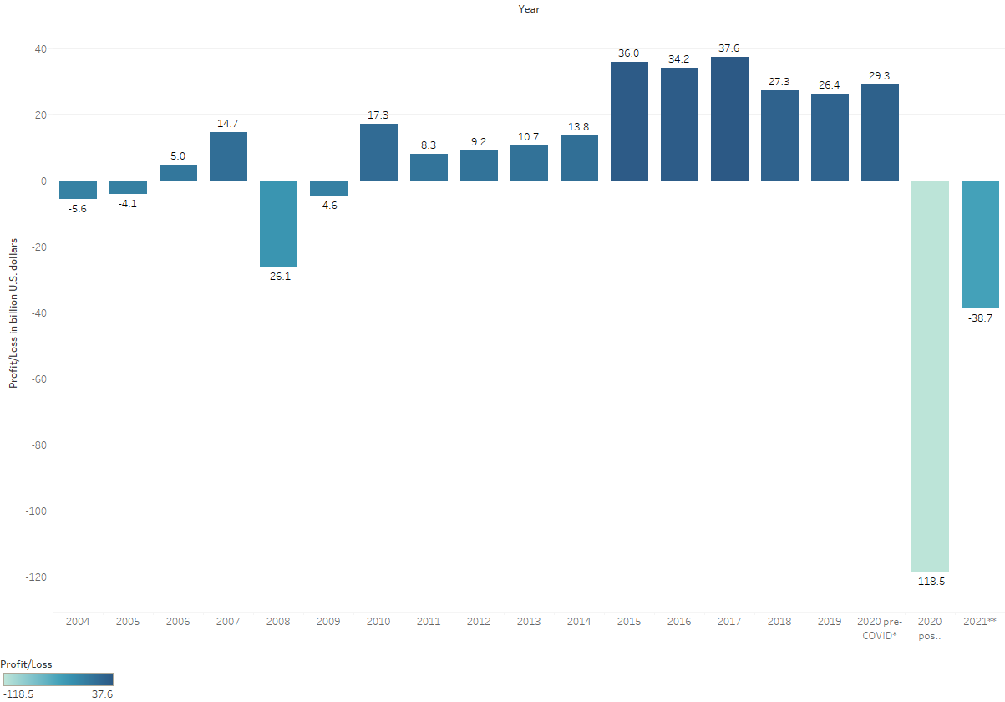
Worldwide Airline Operators Profit/Loss (2004-2020)
From the year 2010 through 2019 global operators saw consistent growth and profit around $30 billion.
In the year 2020 global airline industry saw loss of $89 billions due to covid.
Source: Industry Statistics

Slide 11
Sources
Airline Safety: https://github.com/fivethirtyeight/data/tree/master/airline-safety
Aviation Safety: https://aviation-safety.net/database/
Bureau of Aircraft Accident Archives: https://www.baaa-acro.com/statistics/death-rate-per-year
Airline of America: https://www.airlines.org/dataset/safety-record-of-u-s-air-carriers/#
Industry Statistics: https://www.iata.org/en/iata-repository/publications/economic-reports/
National Highway Traffic Safety Administration Industry Statistics: https://cdan.dot.gov/

Slide 12
Thank You !

